Slide 1
Performance Metrics
Testbet Task by Olajide Usman.

Slide 2
Performance Metrics
Markets: The testbet customers are from 36 different markets/countries.

Slide 3
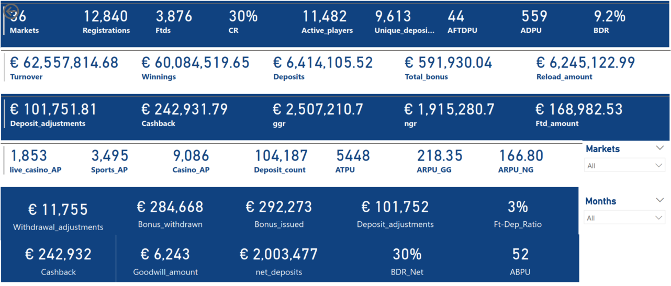
Performance Metrics
YTD (Feb to APR) *Feb was taken to be the start of business year for this brand

Slide 4
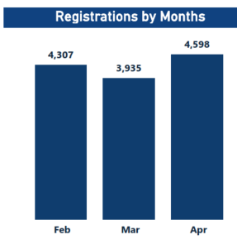
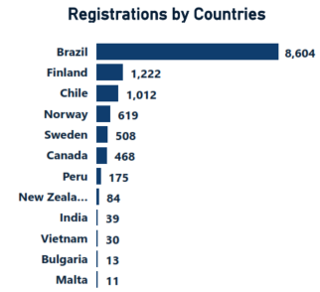
Performance Metrics
Registrations
Registration: April has the highest registration , after the dip in figures in March.
YTD stands at 12,840.
Brazil leads with 8,604, Finland(1,222), Chile(1,012)Norway(619), etc.

Slide 5
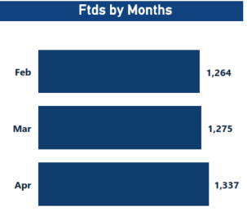
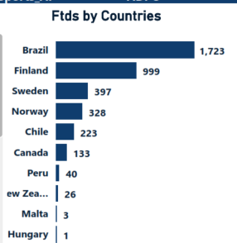
Performance Metrics
FTDS
Registration: April has the highest ftds , after 2 months consecutive improvement.
YTD FTDS stood at 3876.
Brazil leads with 1,723, Finland(999), Sweden(397), etc.

Slide 6
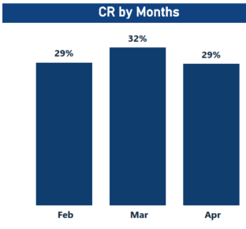
Performance Metrics
CR
Conversion Ratio: The March has the highest rate, but April recorded a drop of 3%.
YTD CR stood at 30%.
Papua New Guinea lead with 100%, thin Finland(82%), Sweden(78%) Norway(53%), etc.

Slide 7
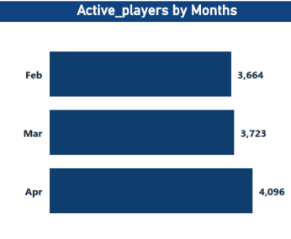
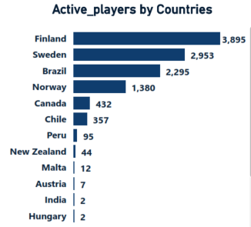
Performance Metrics
Active Players (AP)
Active players: The March has the highest rate, but April recorded a drop of 3%.
YTD active players stood at 11,482.
Finland leads with 3,895, Sweden(2,953), Brazil(2,2965) etc.

Slide 8
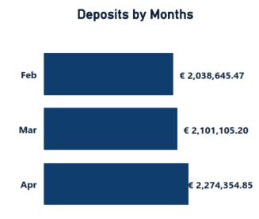
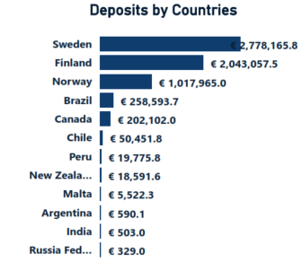
Performance Metrics
deposits
Deposits: This continued to grow MoM, while Apr was the highest with €2.274Million.
YTD deposits stood at €6.414Million.
Sweden leads with (€2.78M), Finland (€2.04M), Norway (€1.02M) , etc.

Slide 9
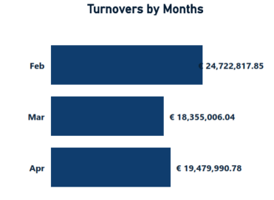
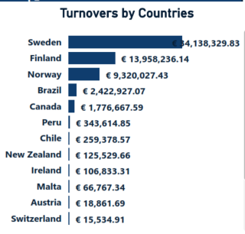
Performance Metrics
Turnovers
Turnovers: This continued to grow MoM, while Apr €19.48Million, trailed Feb’s highest of €24.72Million.
YTD deposits stood at €62.558Million.
Sweden leads with (€34.14M), Finland (€13.96M), Norway (€9.32M) , etc.

Slide 10
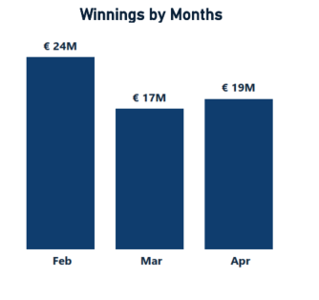
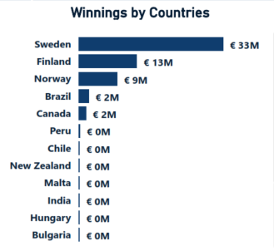
Performance Metrics
winnings
Winnings: April recorded €19M, while Feb’s €24M is still the highest.
YTD deposits stood at €60.08Million.
Sweden leads with (€33M), Finland (€13M), Norway (€9M) , etc.

Slide 11
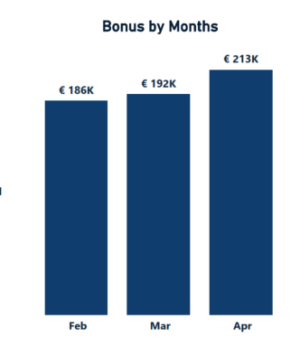
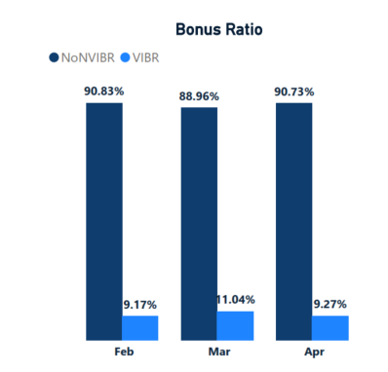
Performance Metrics
BOnus
Bonuses: Monthly bonus continued to be on the increase MoM , with Apr giving €213k
YTD bonuses stood at €591.93k.
The VIP takes an average of 9.82% of the total bonuses given.

Slide 12
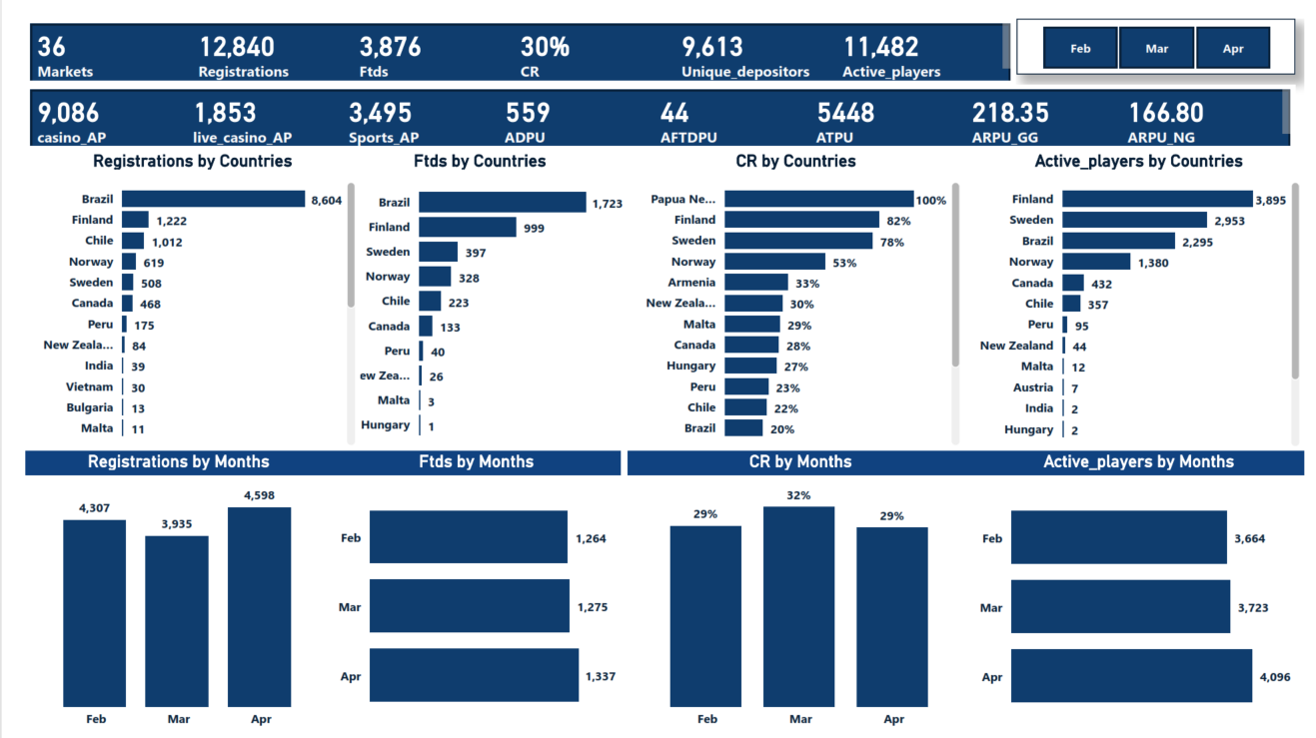
Performance Metrics
Viz 1

Slide 13
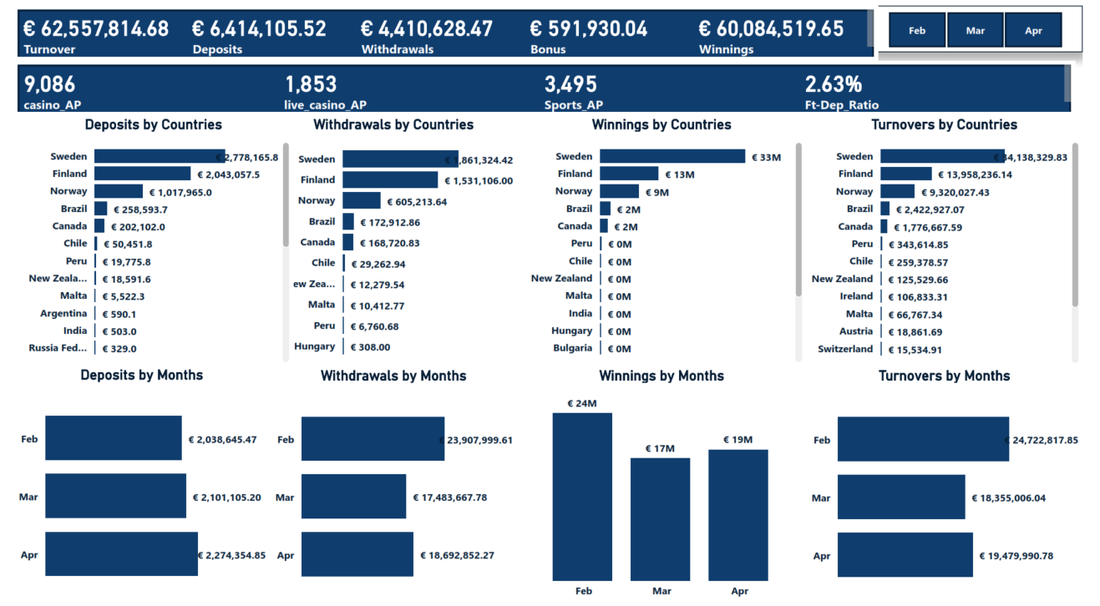
Performance Metrics
Viz 2

Slide 14
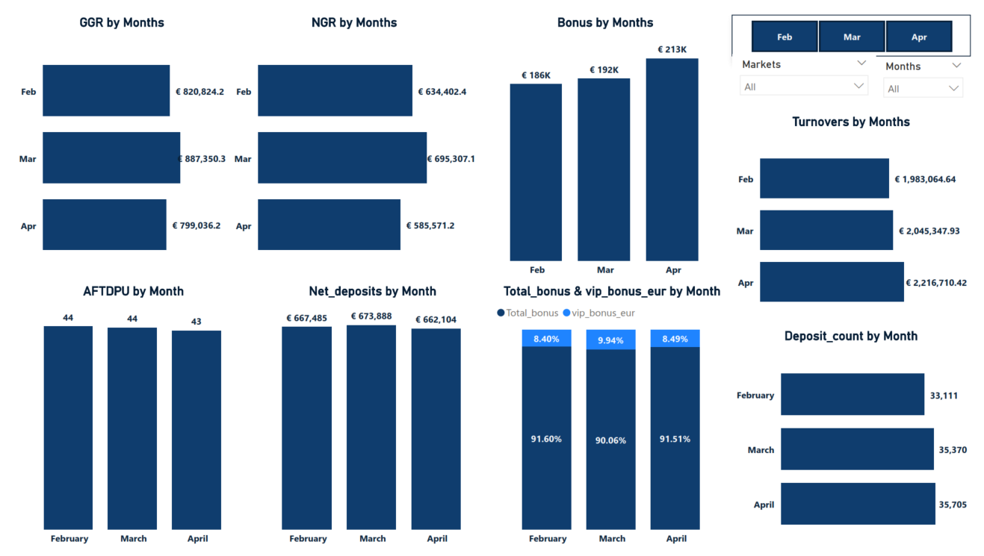
Performance Metrics
Viz 3

Slide 15
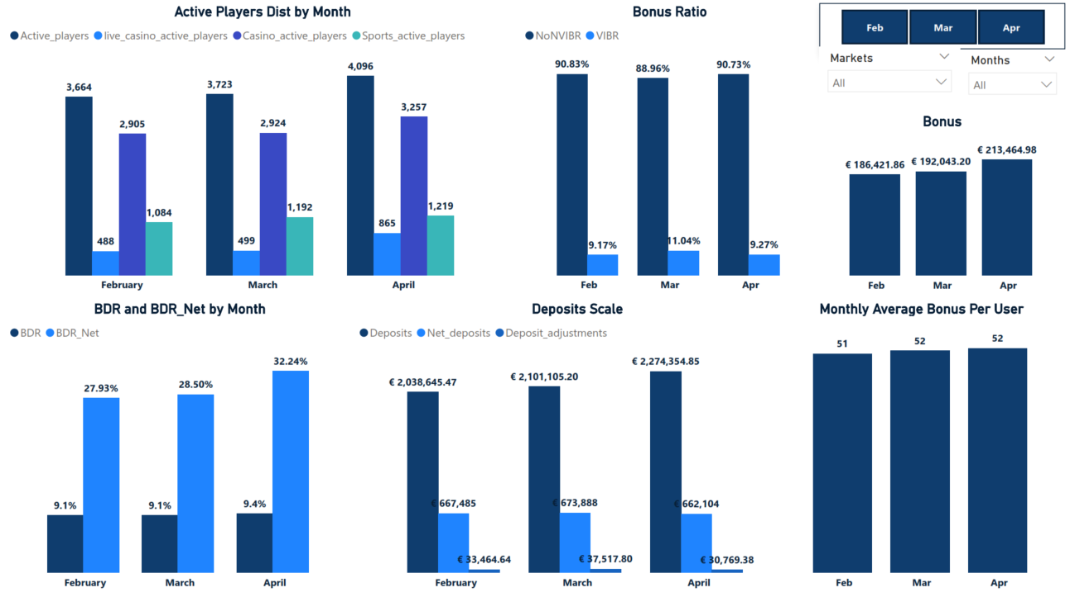
Performance Metrics
Viz 4

Slide 16
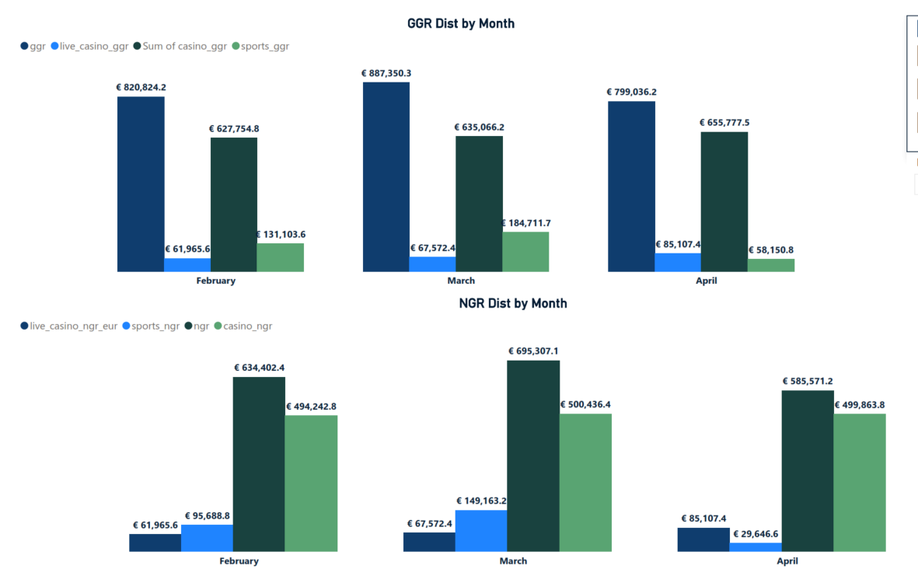
Performance Metrics
Viz 5

Slide 17
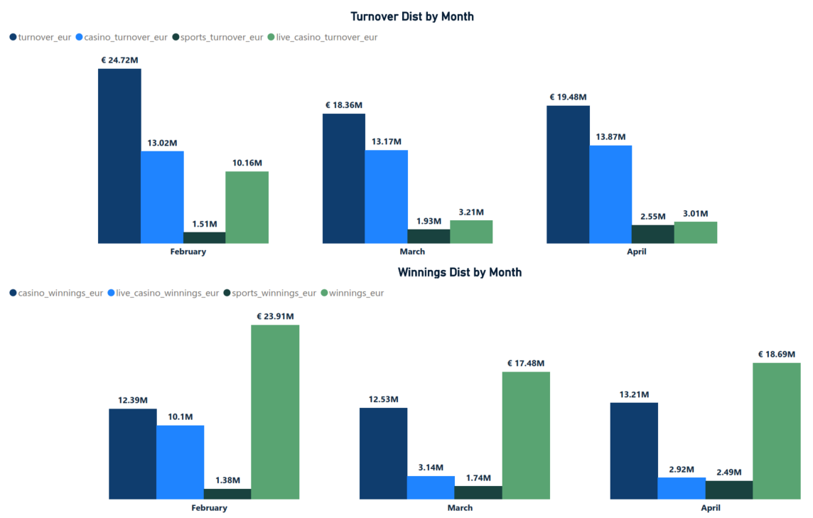
Performance Metrics
Viz 6

Slide 18
Findings & suggestions
Conversion & FTDS Overall conversion ratio stood at 30%, this is a reflection on the quality of registrations brought in total. The common industry average CR for the grey market ranges from 21-35%. Affiliate account managers should endeavour to enlighten their affiliates on the need to bring quality players.
Countries with CR lower than 30% should also be monitored. Affiliate_IDs under them should be checked for FTDS that had just a single deposit, compared to those that have several deposits: This will aid in fraud analysis check.
CRM& Customer care dataset should also be checked to see if they are engaging the churned customers, and how they are engaging them. Churn rate analysis should be constantly done.
A further review of the first-time deposit attempt metric( that’s if it’s captured in the data warehouse.) will shed more light on whether the low conversion rate is caused by the payment gateway(payment solution provider). Acceptance Ratio(%)= FTDS/ FTDS attempts.
Trends of Count of FTDS by payment gateway will also aid in this regard.

Slide 19
Findings & suggestions
Bonus & Deposit Amount ABPU(51.7€) is more than AFTDPU(43.7€). This means the average bonus paid to users is higher than the average deposits gotten from them. The bonus offers should be carefully reviewed and monitored.
Ftd_amount_eur should also be broken down into deposit brackets, so that a frequency table/histogram would reveal patterns. If there exist deposit simulations from a particular affiliate_ID, it can be easily spotted.
BDR_Net keeps going up monthly, while net deposit keeps falling. This shows correlation of bonus abuses.

Slide 20
Findings & suggestions
Active Players Distribution
Game of chance, GOC(casino and live casino) have more players acceptance than the sportsbook. User acceptance test, odds competitiveness, number of available events, number of market options available on the SB should be frequently checked. Market research analysis can also assist to unravel an unusual pattern, e.g South American countries are known to be football loving nations, so SB players should outnumber GOC.
This is to reduce the over-reliance on GOC, despite the impressive turnover from GOC.

Slide 21
Findings & suggestions
Turnover per user & Cost of Acquisition per user
The ATPU of 5448 could not be compared to the CPA(cost per acquisition: what it cost to acquire a single user), because the total amount spent on affiliates or acquisition was not available. At no time should the CPA be higher than ATPU, but there can be exceptions if the cost was incurred by advertising just for brand awareness only. ROI was purely for awareness sake only. Clicks/hits and high values of registration would buttress this.

